Slide 1

Notes:
_note: This session helps Year 8 students understand the endocrine system, identify endocrine disruptors in everyday products, and make informed choices about personal care without fear or overwhelm.
image_brief: {"subject":"human body silhouette","mood":"calm","elements":["glowing glands","flowing energy lines","soft light"]}
image_generation_skipped: slide_01

Slide 2
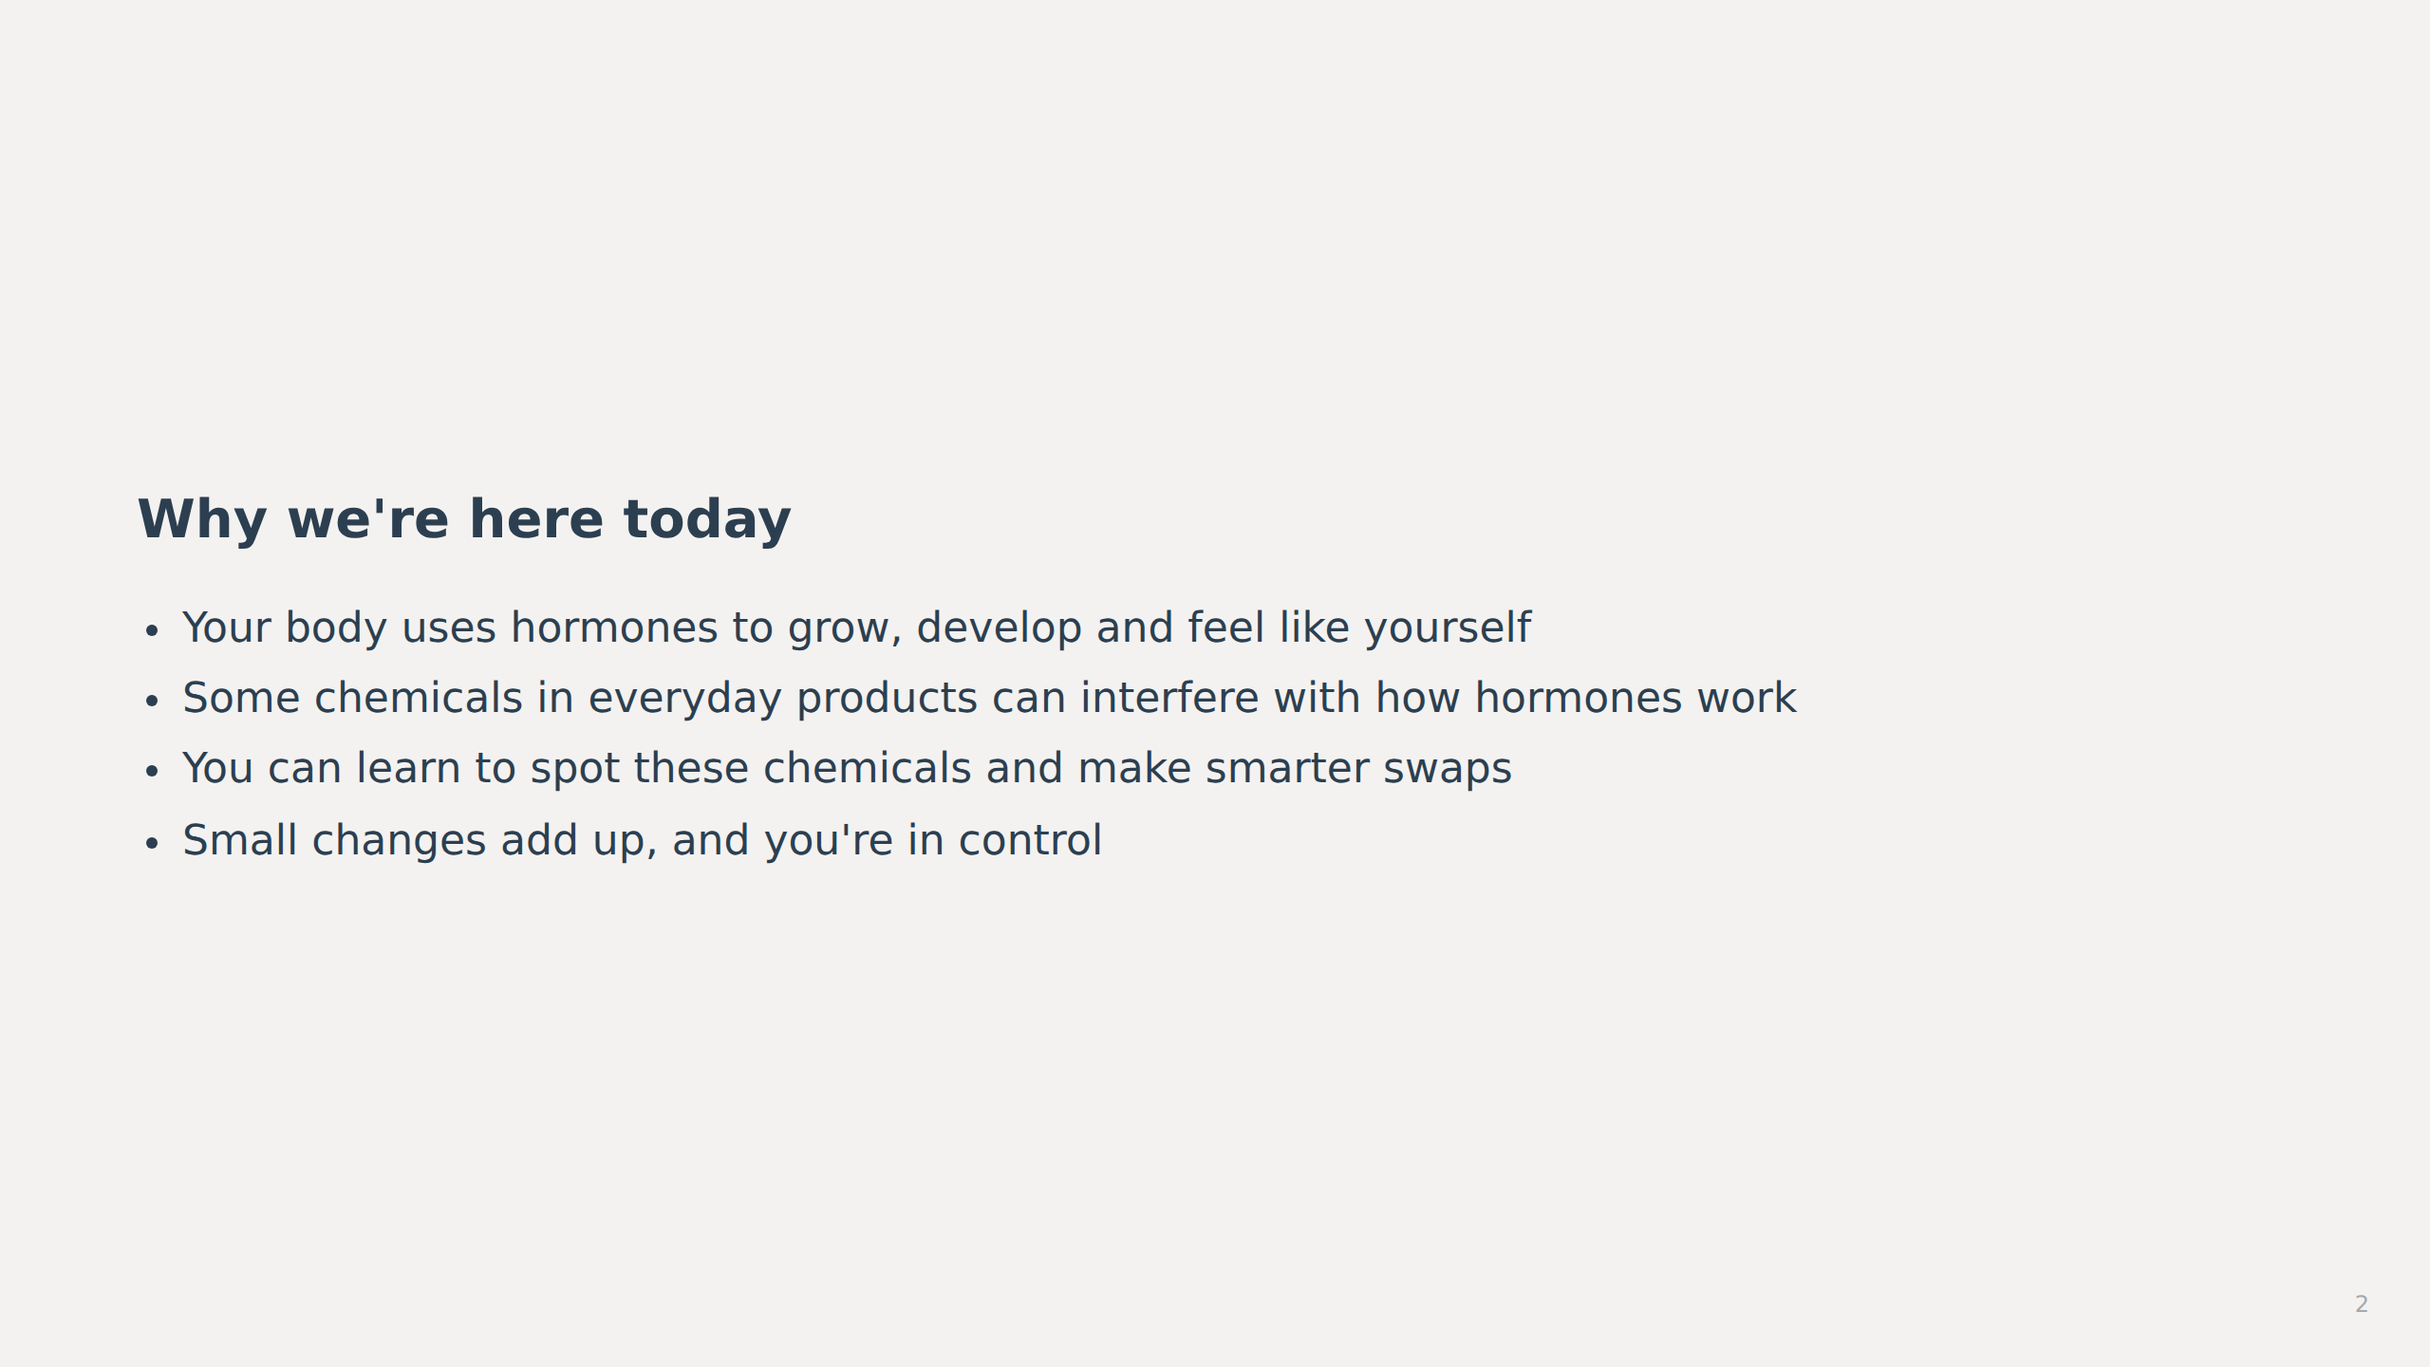
Notes:
_note: Frame this as empowerment, not alarm. Hormones are relevant to Year 8 because they're experiencing rapid hormonal change. The goal is to build confidence in reading labels and making choices, not to create anxiety.
image_brief: {"subject":"teenager choosing products","mood":"curious","elements":["product labels","question marks","light bulb"]}
image_generation_skipped: slide_02

Slide 3
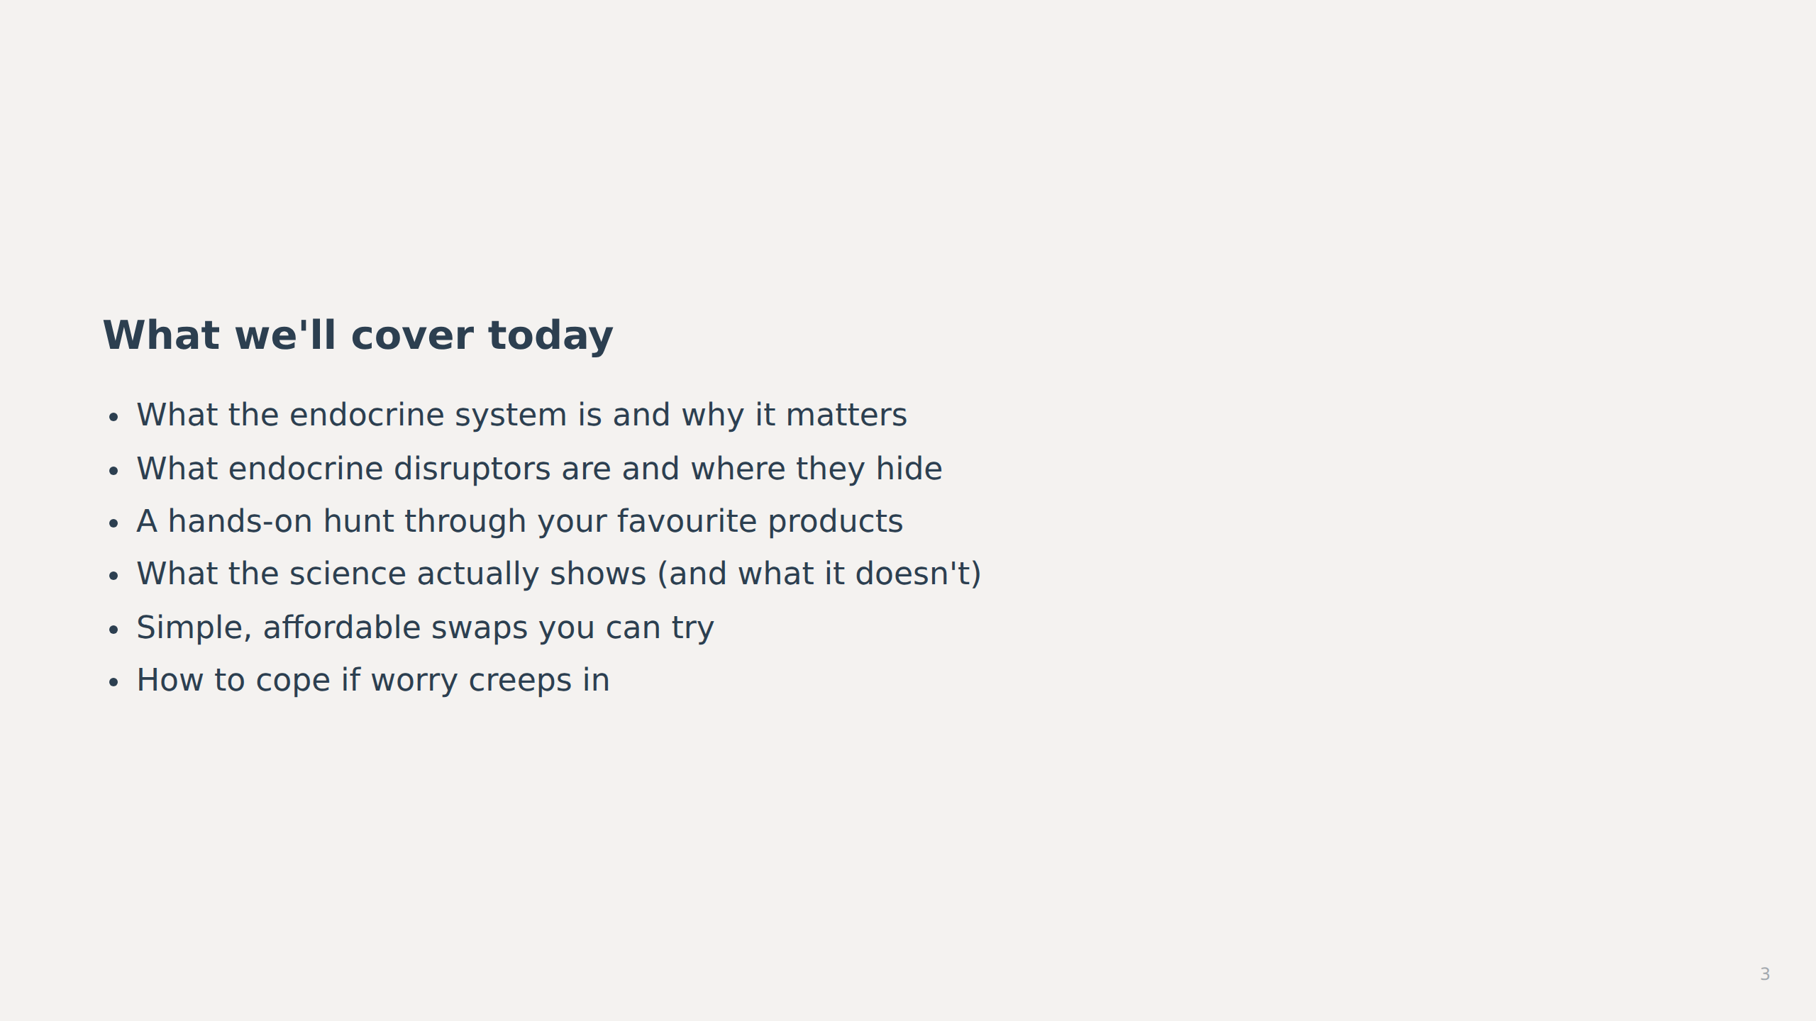
Notes:
_note: This agenda mirrors the synthesis modules. Keep it concrete and activity-focused so students know they'll be doing, not just listening.
image_brief: {"subject":"agenda checklist","mood":"organised","elements":["checkmarks","glands diagram","product bottles","swap arrows"]}
image_generation_skipped: slide_03

Slide 4
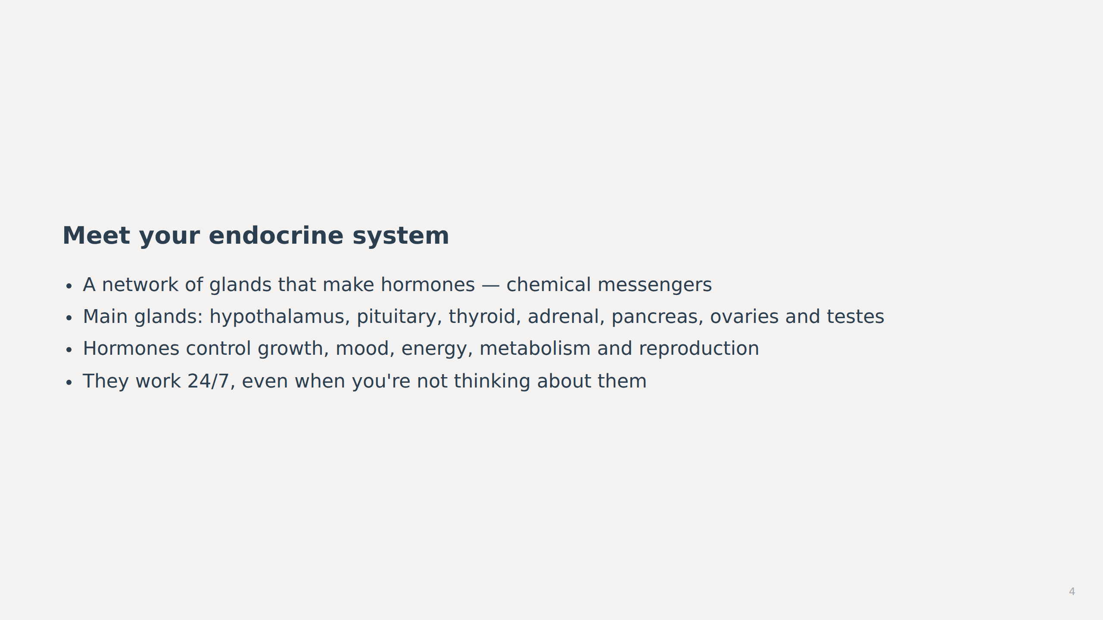
Notes:
_note: Use a simple diagram showing the main glands and their locations. Emphasise that hormones are normal, necessary and always working. This is not scary — it's how bodies function. Students at this age are experiencing hormone changes firsthand, so make it relatable: "Your hormones are why you're growing, why your mood shifts, why you need more sleep."
image_brief: {"subject":"endocrine glands in body","mood":"educational","elements":["gland locations","hormone symbols","growth indicators"]}
image_generation_skipped: slide_04

Slide 5
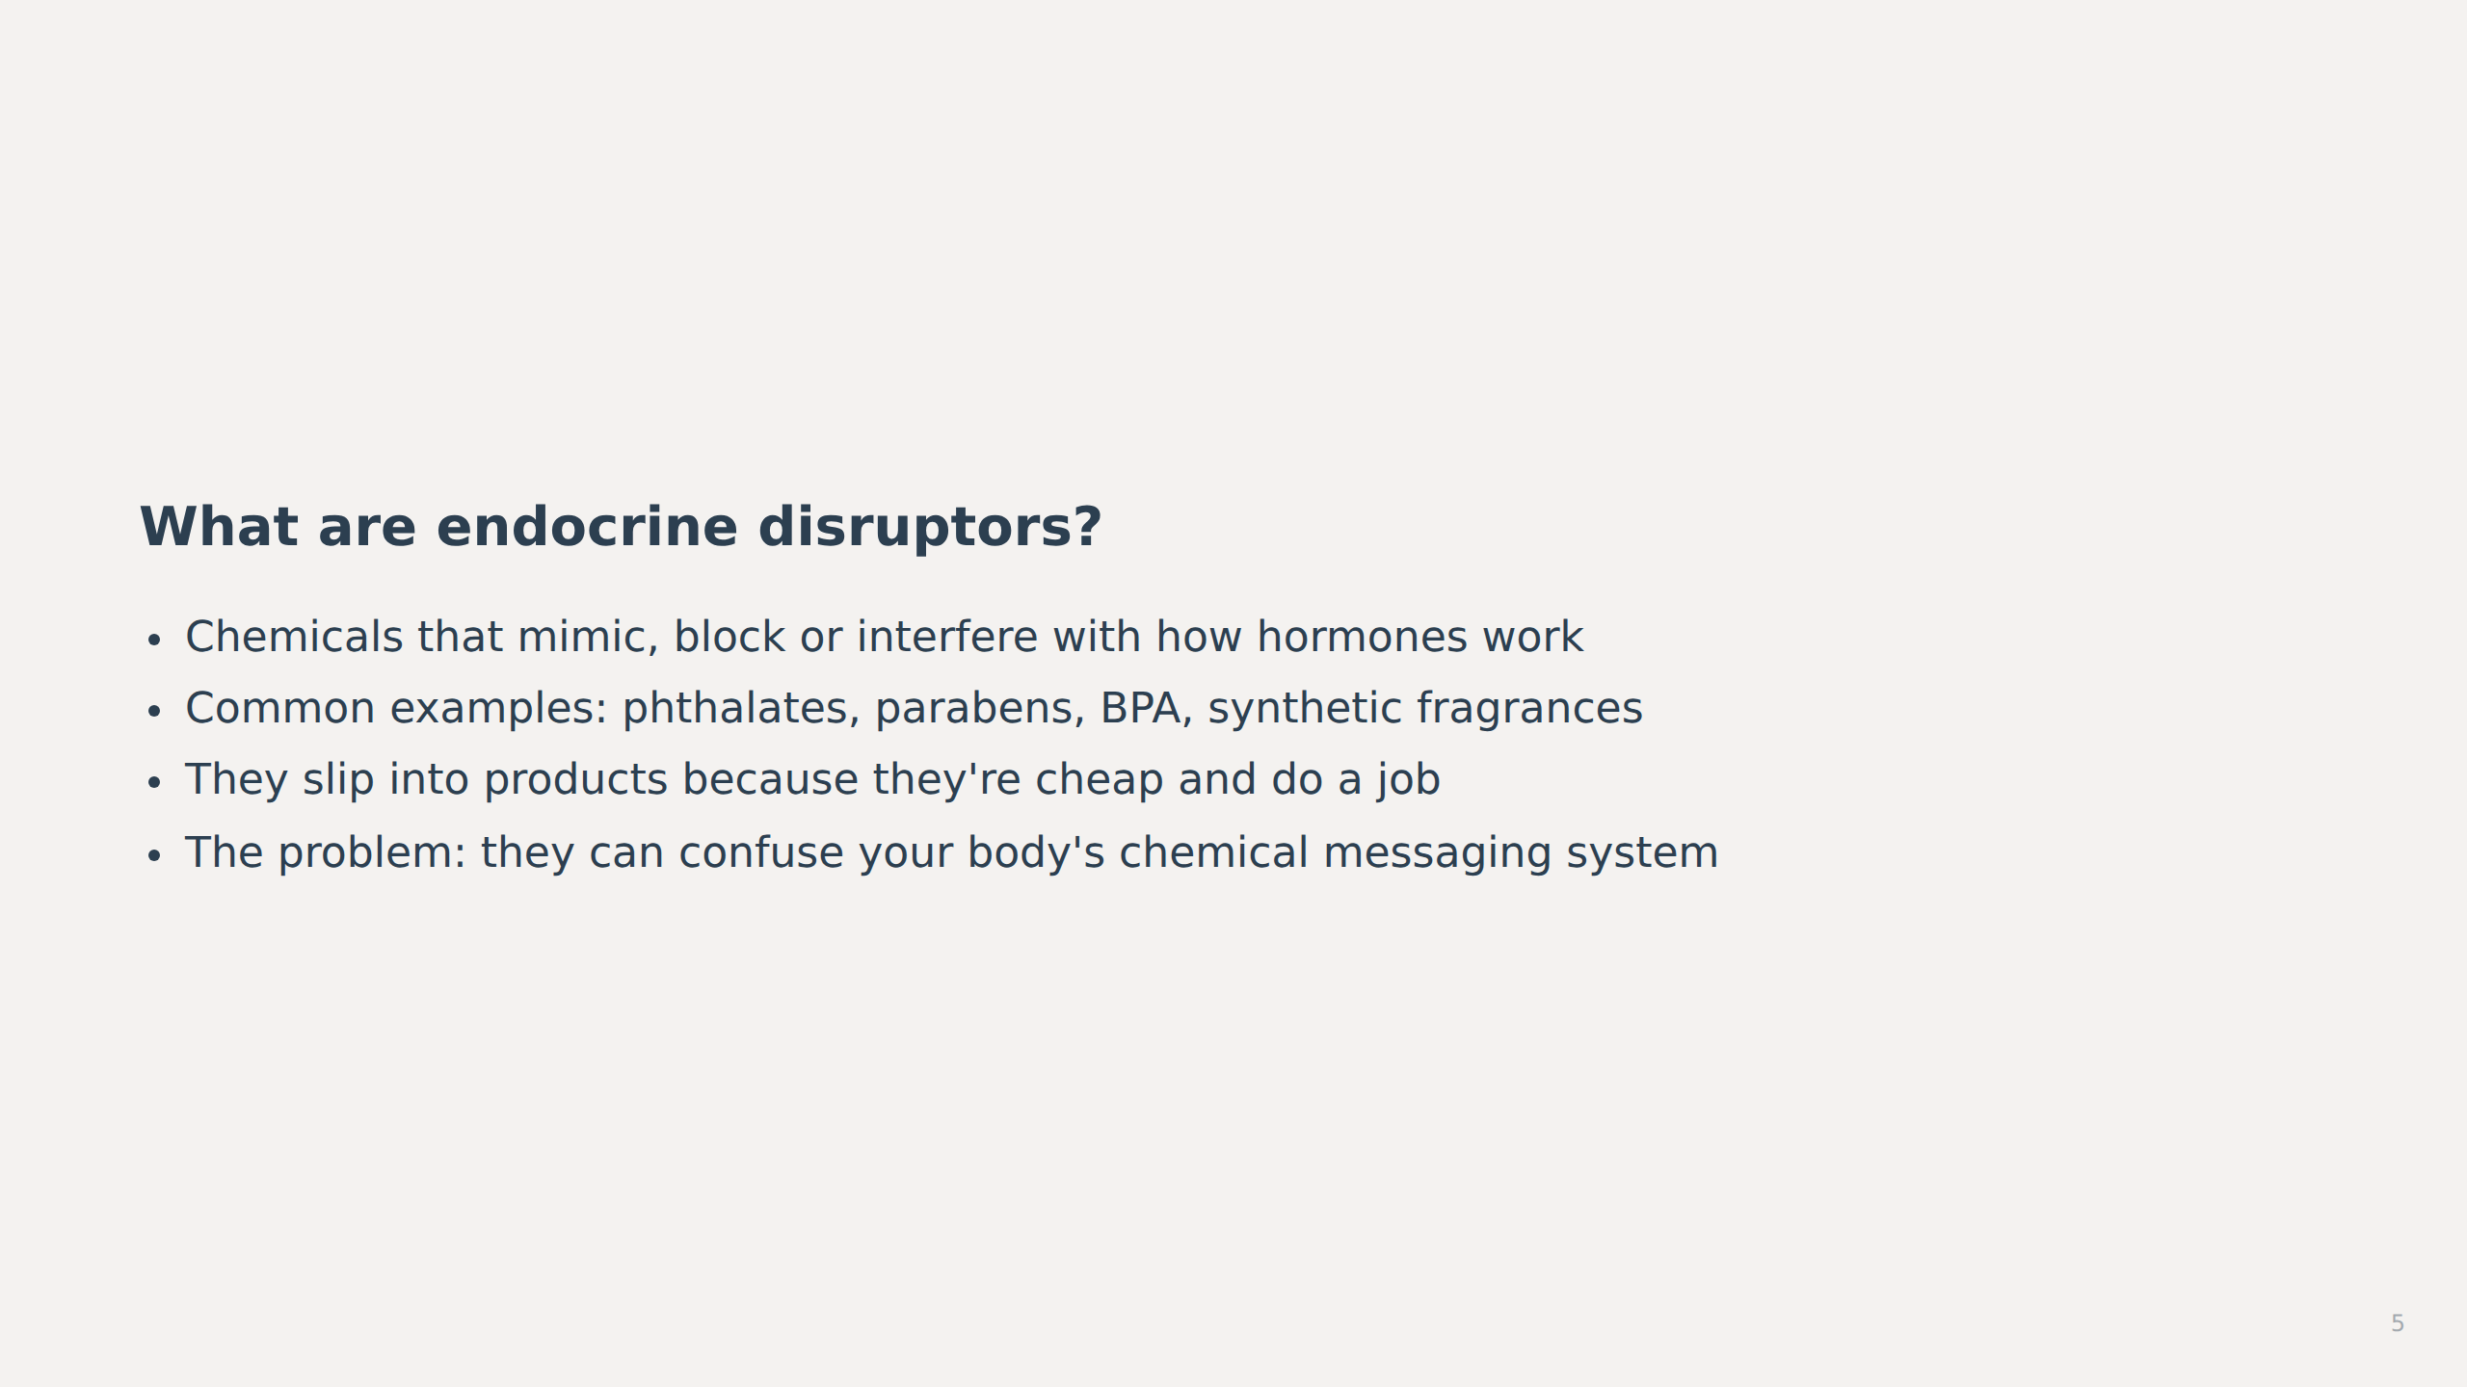
Notes:
_note: Keep the explanation simple and concrete. Use the analogy of a radio signal: hormones are messages, and disruptors are static that scrambles the signal. Avoid jargon. Emphasise that these are real chemicals with real effects — not imaginary — but also that exposure is manageable and reducible.
image_brief: {"subject":"chemical molecules","mood":"neutral","elements":["molecular structures","interference waves","product ingredients"]}
image_generation_skipped: slide_05

Slide 6
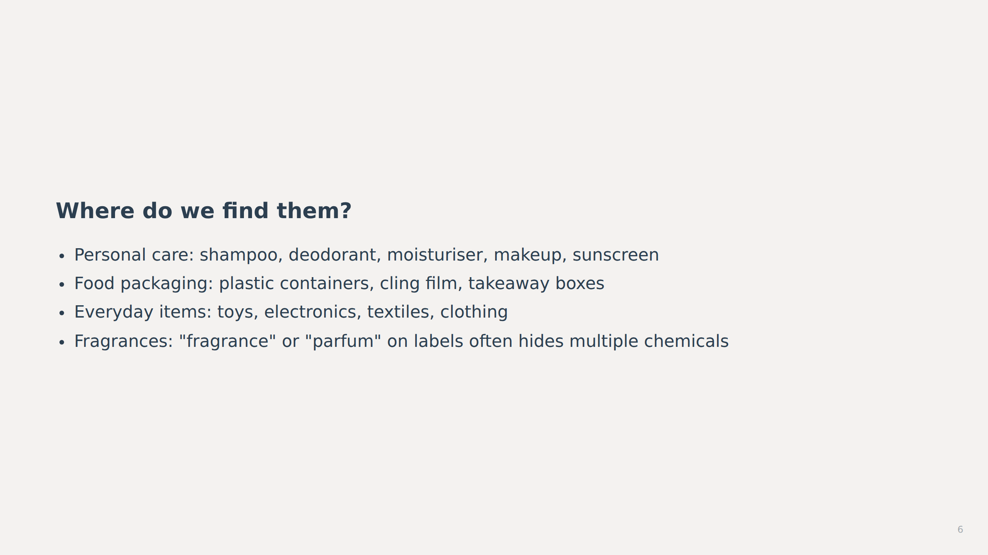
Notes:
_note: This is where the "hormone-disruptor hunt" activity happens. Bring in real product labels or ask students to bring their own. Show them how to read ingredient lists and spot red flags. Use a simple checklist: avoid "fragrance/parfum", parabens, phthalates, BPA. Introduce tools like EWG's Skin Deep or SkinSAFE if you have internet access. Make it interactive and fun — this is detective work, not doom-scrolling.
image_brief: {"subject":"product labels and ingredients","mood":"investigative","elements":["magnifying glass","ingredient lists","warning symbols"]}
image_generation_skipped: slide_06

Slide 7
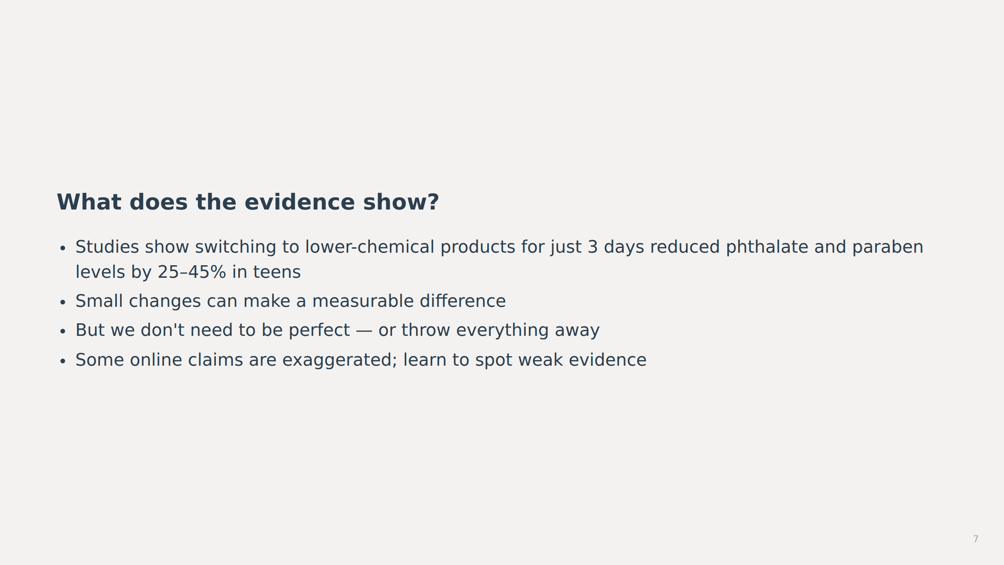
Notes:
_note: This is the reassurance slide. Emphasise that the evidence is real but not catastrophic. A 25–45% reduction in 3 days shows that exposure is reversible and that choices matter. Teach critical thinking: "Is this based on animal studies, cell studies, or actual human evidence?" Myth-bust gently: "Some claims online are real, but many are exaggerated or misleading. We can learn to tell the difference."
image_brief: {"subject":"research data visualization","mood":"balanced","elements":["bar charts","percentage symbols","evidence scales"]}
image_generation_skipped: slide_07

Slide 8
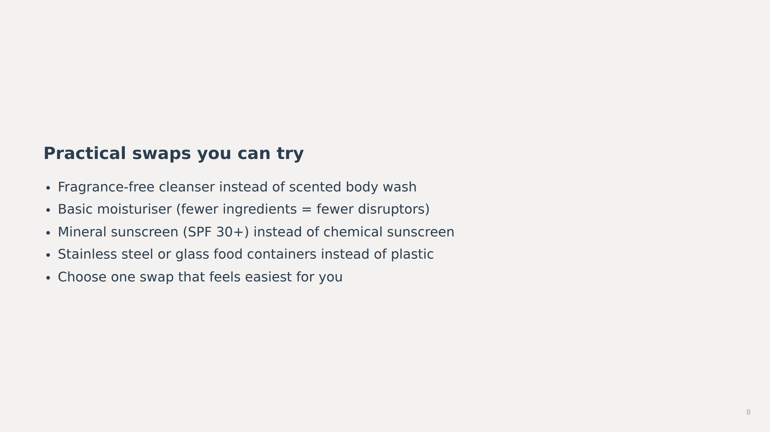
Notes:
_note: Emphasise affordability and accessibility. These swaps don't have to be expensive or trendy. A basic moisturiser from a supermarket is fine. Stainless steel water bottles are often cheaper than branded alternatives. Partner talk: ask students to choose one swap they could try this week and why it feels doable. This builds self-efficacy and prevents overwhelm.
image_brief: {"subject":"everyday product alternatives","mood":"practical","elements":["swap arrows","simple products","checkmark"]}
image_generation_skipped: slide_08

Slide 9
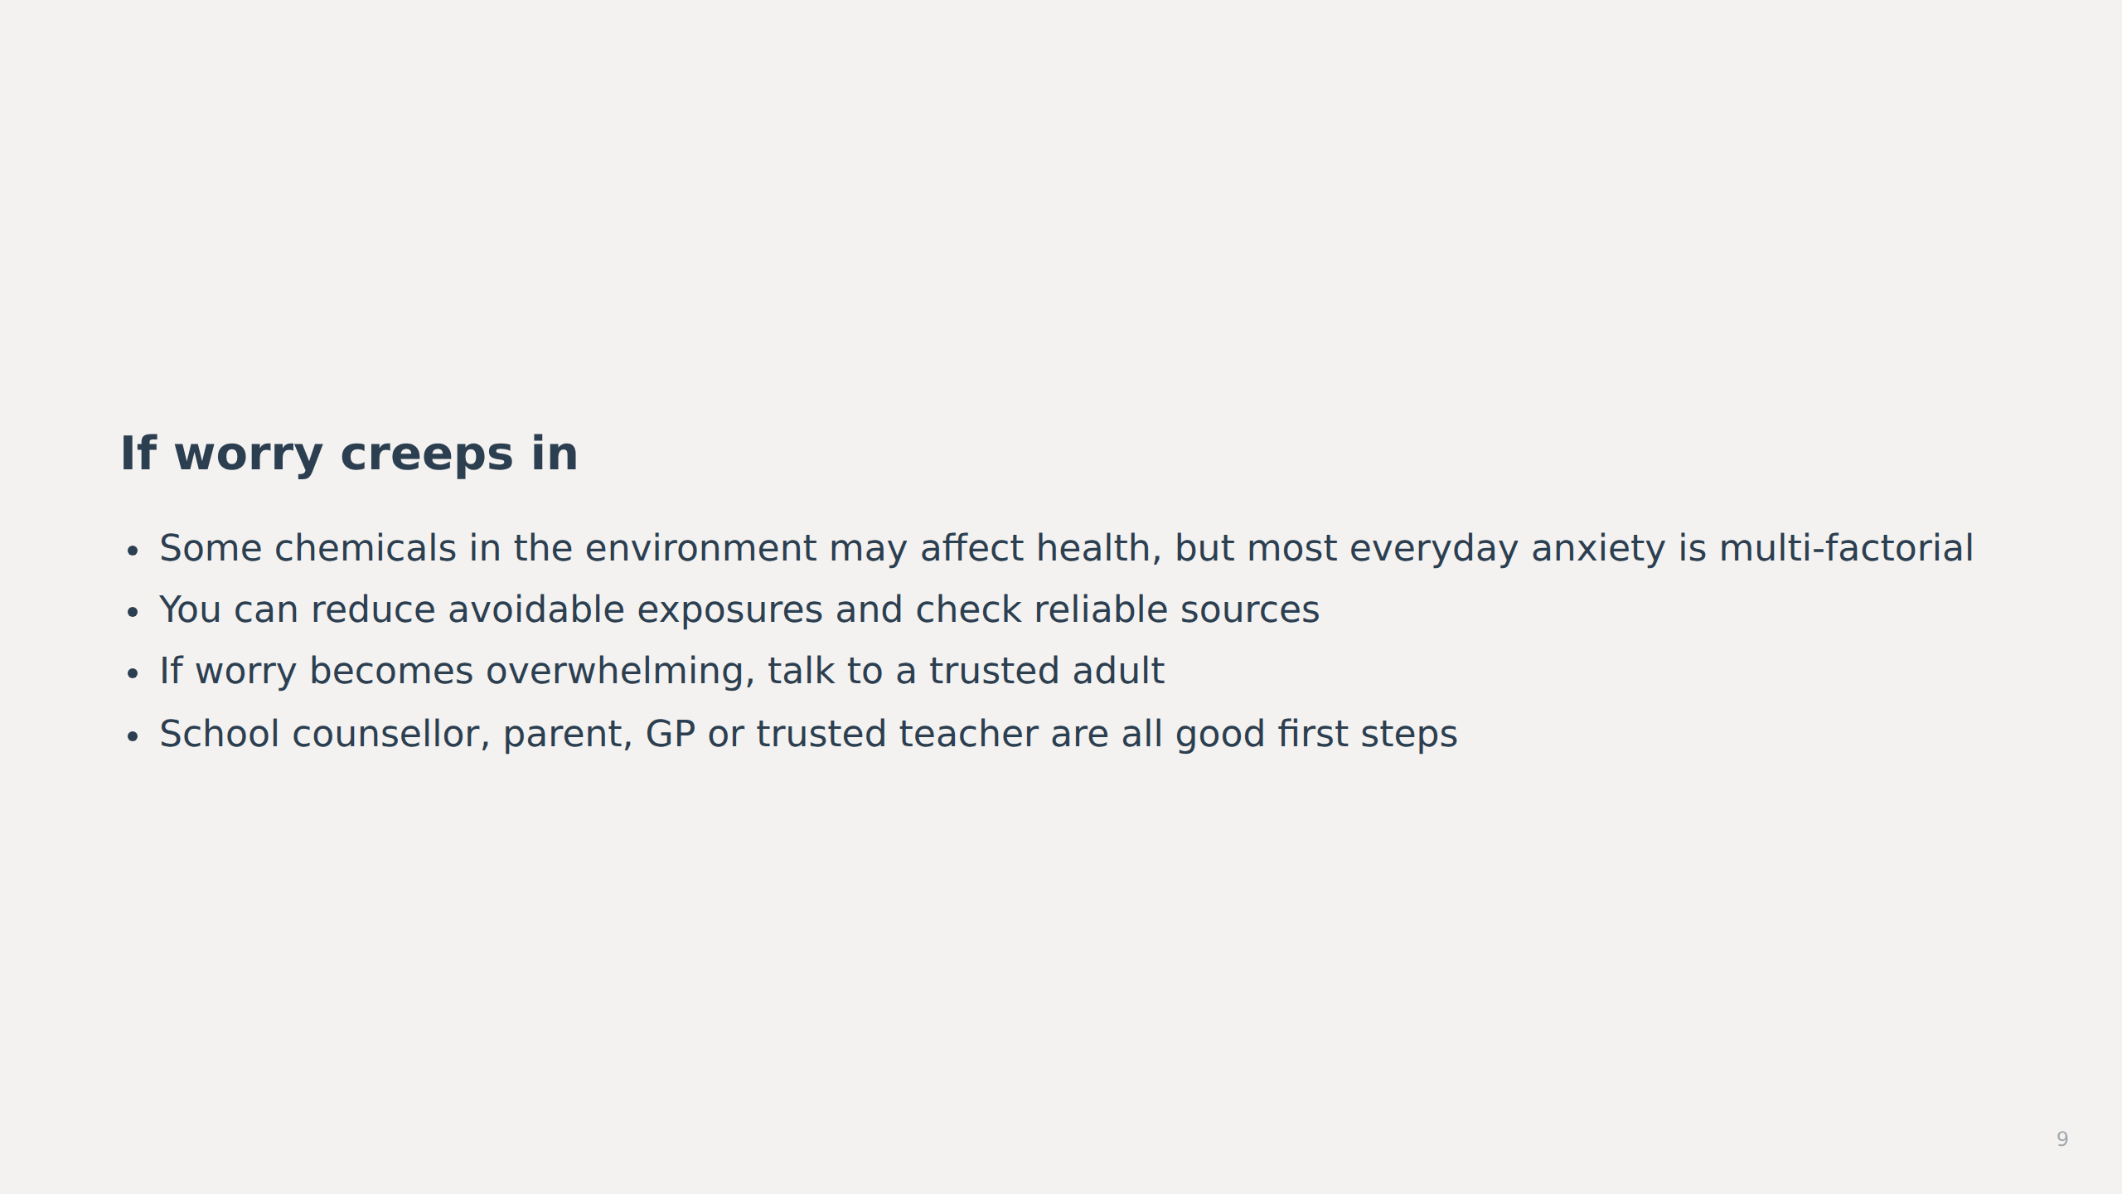
Notes:
_note: This is the safeguarding slide. Acknowledge that worry about chemicals is valid, but frame it as manageable. Pair EDC education with mental health support. Make it clear that anxiety about health can have many causes — not just chemicals — and that support is available. Normalise seeking help: "If you feel worried, that's okay. Here's what you can do."
image_brief: {"subject":"supportive conversation","mood":"reassuring","elements":["two people talking","heart symbol","support network"]}
image_generation_skipped: slide_09

Slide 10
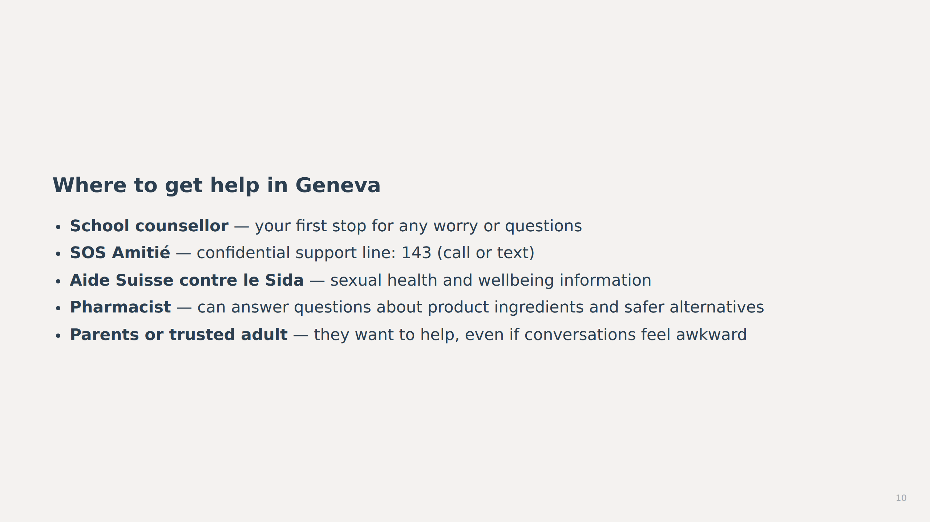
Notes:
_note: These are evidence-based local resources for Geneva, Switzerland. The school counsellor is the universal first step. SOS Amitié is a well-established Swiss helpline. Pharmacists are accessible and knowledgeable about product safety. Encourage students to talk to parents or carers — frame it as a conversation, not a crisis. If the school has specific local resources (e.g., a school nurse, local health centre), add those here.
image_brief: {"subject":"support resources network","mood":"connected","elements":["phone symbol","helping hands","information signs"]}
image_generation_skipped: slide_10

Slide 11
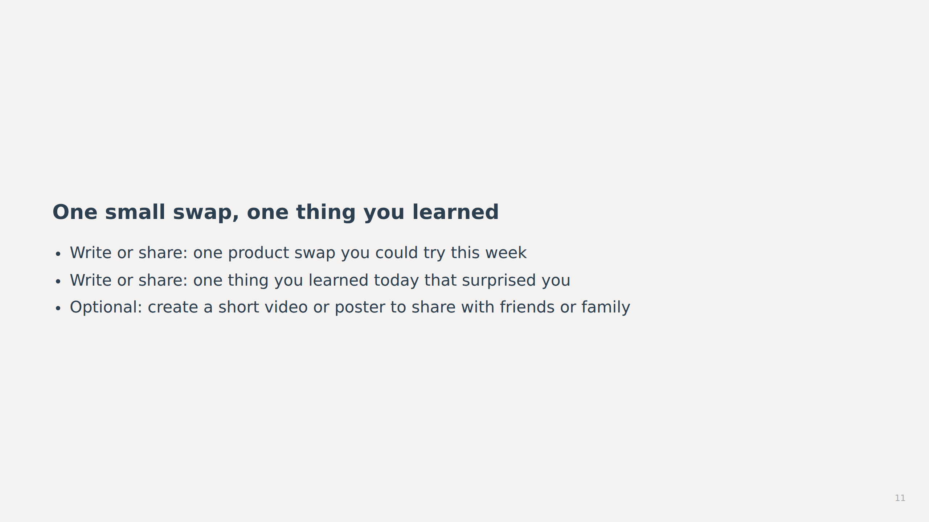
Notes:
_note: This is the reflection and consolidation slide. Keep it low-pressure. Students can write privately or share aloud in pairs. The goal is to cement learning and build agency. Emphasise that they now know what endocrine disruptors are, where they're found, which changes are reasonable, what the evidence does and does not show, and how to get help if they need it. End on a note of empowerment: "You're in control of these choices."
image_brief: {"subject":"student reflection moment","mood":"thoughtful","elements":["notebook","lightbulb","growth arrow"]}
image_generation_skipped: slide_11

Slide 12
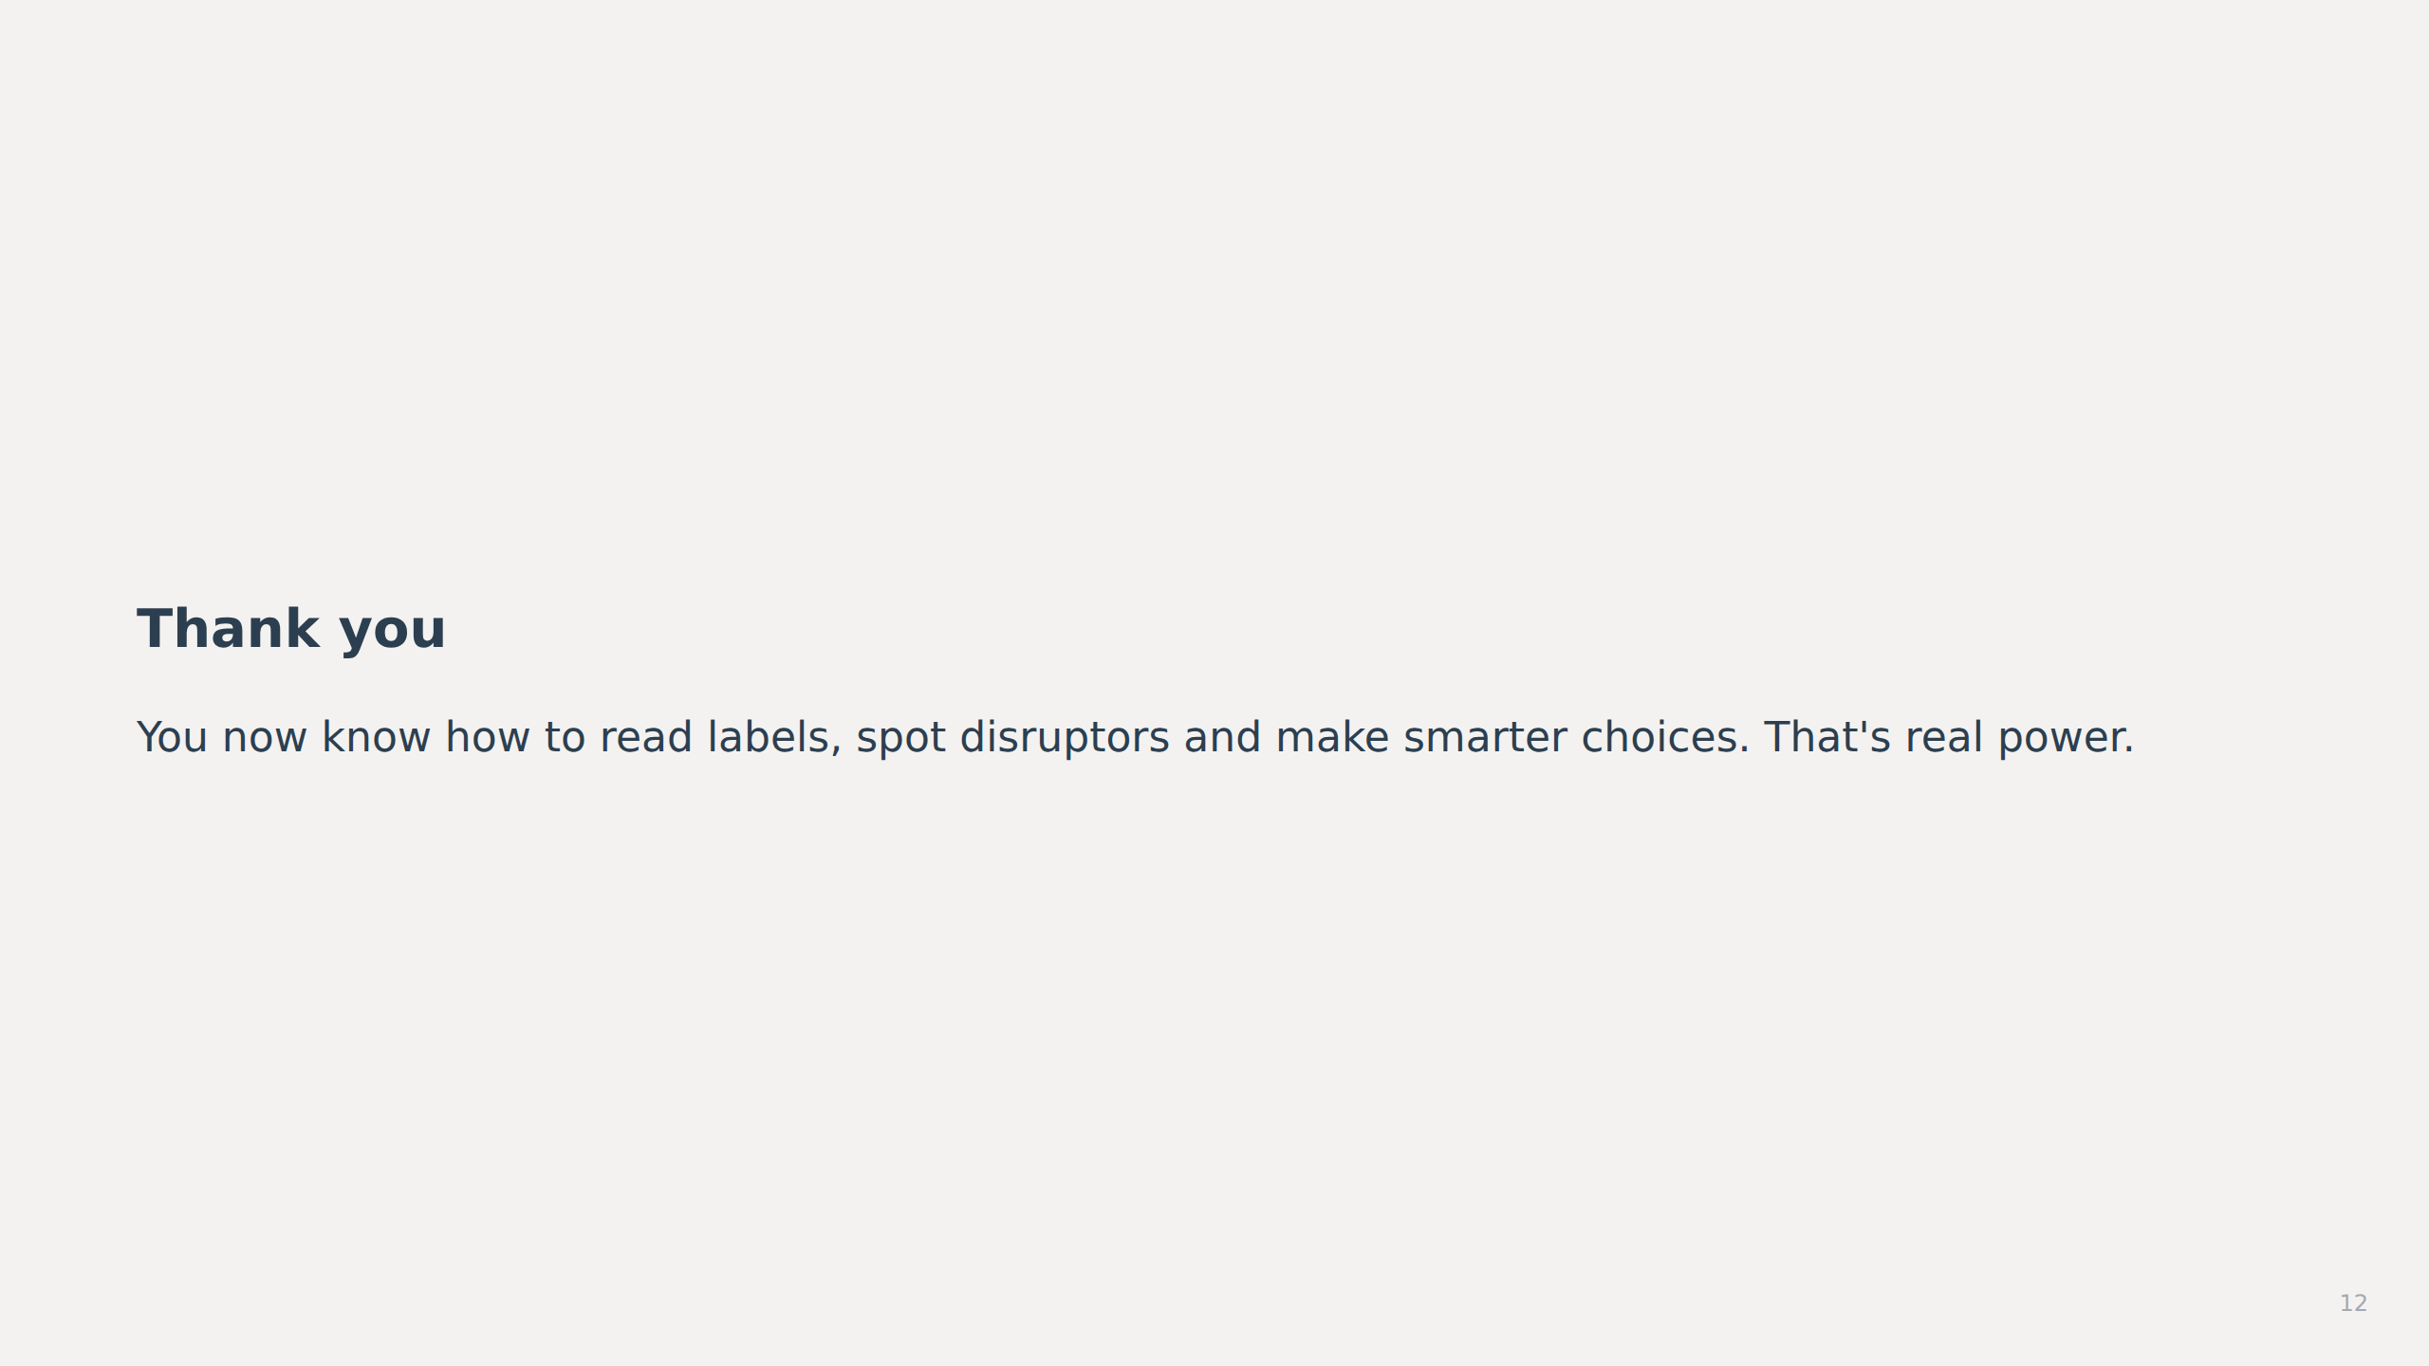
Notes:
_note: Close warmly and confidently. Reinforce that they have learned practical, usable skills. Leave space for questions. If you have a QR code linking to a resource sheet or video, place it here.
image_brief: {"subject":"empowered young person","mood":"confident","elements":["forward motion","knowledge symbol","choice"]}
image_generation_skipped: slide_12

